Slide 1

EDU BRIDGE
TEAM OF JAVA FULL STACK DEVELOPER
“HEALTH CARE MANAGEMENT SYSTEM”
Submitted by: Under the Guidance of :
DEEKSHA K Trainee INDRAKKA MALI MAM
HRUTIK GURAV
SHABHARIRAJ
PRIYANKA PATIL
SABARIGIRI

Slide 2
CONTENTS
INTRODUCTION
REQUIREMENTS
ADVANTAGES
DISADVANTAGES
SPRING BOOT
POST MAN
MY SQL
CODING
CONCLUSION
FUTURE WORK

Slide 3
OBJECTIVE:
Our main is to financially protect Below Poverty Line (BPL) families from monetary burdens and liabilities that are a result of unfortunate health-related situations and emergencies. Under this scheme, the beneficiaries are eligible .

Slide 4
INTRODUCTION
For every human being in a world health is very important.
Hospitals , clinics and community health agencies can be very different from other work environments
Health care management systems are complex and there are many things need to know about types of hospital systems , patient care , insurance , health care providers and legal issues.
As we work with the patients we will be understood about different types of insurance , like how to protect rights and privacy
We need to know what community resources are available and how to access those services for patients.
Insurance funds are managed by different third party institutions , in some systems the managing organization may also own or manage the service providers.

Slide 5
REQUIREMENTS:
HARDWARE REQUIREMENTS:
Hard Disk
Internal Memory
Mouse
Key board
Display
SOFTWARE REQUIREMENTS:
Spring Boot
Post Man
My Sql

Slide 6
ADVANTAGES:
The increasing prevalence of lifestyle diseases such as diabetes , hypertension , stroke and heart attack among the young as well as the elder people in INDIA is becoming a major cause of concern.
Having a family history of these conditions does not ensure protection from related complications
In today’s fast paced life we must be prepared for a medical contingency at all time where a robust health insurance policy can help
One of the major health insurance benefits is that it allows us to take

Slide 7
DISADVANTAGES
Free, continuous and reliable information wasn’t always available.
Lack of adequate information was a hindrance to arrive at a proper
conclusion.
➢The preference of consumers regarding various company policies may
vary by their own analysis and observations from time to time

Slide 8
SPRING BOOT
Spring Boot is an open source Java-based framework used to create a micro service
➢ Micro Service is an architecture that allows the developers to develop and deploy services independently. Each service running has its own process and this achieves the lightweight model to support business applications.
Advantages :
▪ Simple scalability
▪ Compatible with Containers
▪ Minimum configuration
▪ Lesser production time
▪ Easy deployment

Slide 9
POST MAN
Post man is an API platform for building and using API’s .
Post man simplifies each step of the API lifecycle and streamlines
collaboration so you can create better.
Post man is the place to find an official information on how to use post man in API projects.
Workflow in post man :
Making Requests
Building and managing APIs
Publishing APIs
Collaborating with team
Developing in team

Slide 10
MY SQL:
MySQL is a database system used for developing web-based software applications.
MySQL used for both small and large applications.
MySQL is a relational database management system (RDBMS).
MySQL is fast, reliable, and flexible and easy to use.
MySQL supports standard SQL (Structured Query Language)
KEY POINTS
Database
Table
Primary Key
Foreign Key

Slide 11
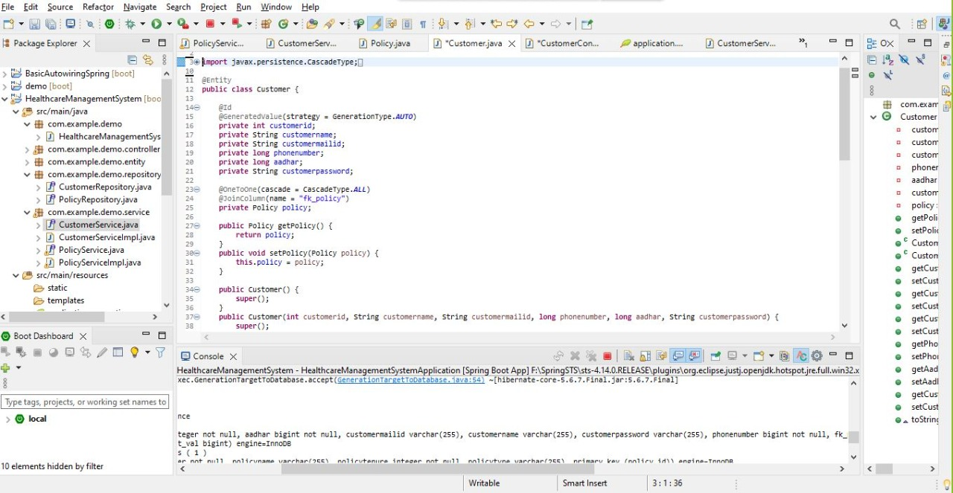
CODING
@Entity
The annotation specifies that the class is an entity and is mapped to a database table
@Id
The annotation is inherited from javax.persistence.Id indicating the member field below is the primary key of current entity
@ one to one
The column is set as unique , that is object can be associated with a single employee object.

Slide 12
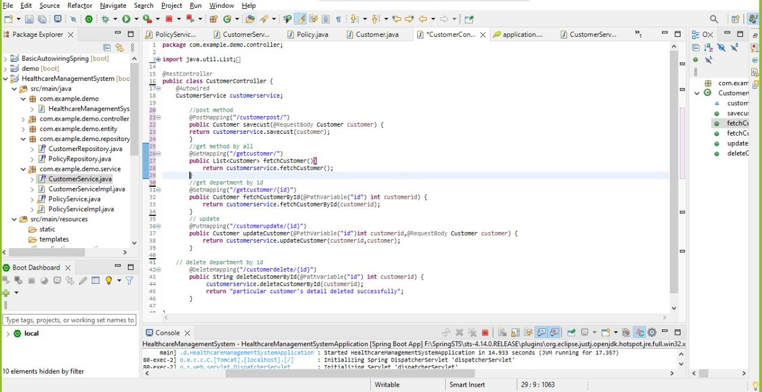
@Rest Controller
RestController is a Spring annotation that is used to build REST API in a declarative way.
RestController annotation is applied to a class to mark it as a request handler, and Spring will do the building and provide the restful web service at runtime
@Autowiring
The @Autowiring annotation can be used to autowire bean on the setter method just like @Required annotation, constructor, a property or methods with arbitrary names and/or multiple arguments.

Slide 13
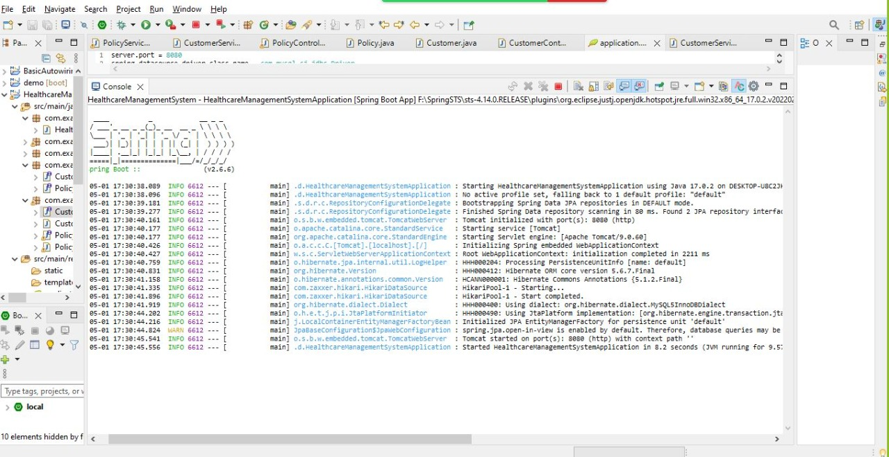
RESULT OF SPRING BOOT
It automatically configures all the application

Slide 14
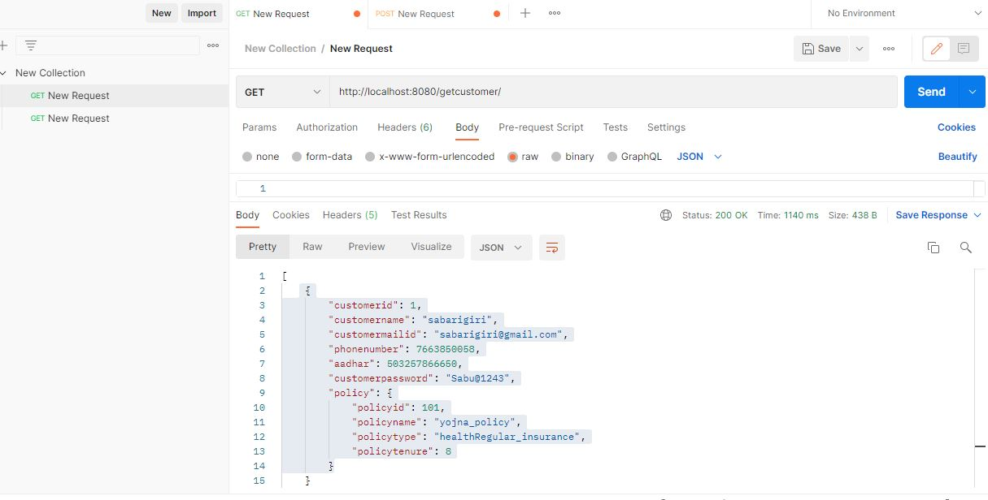
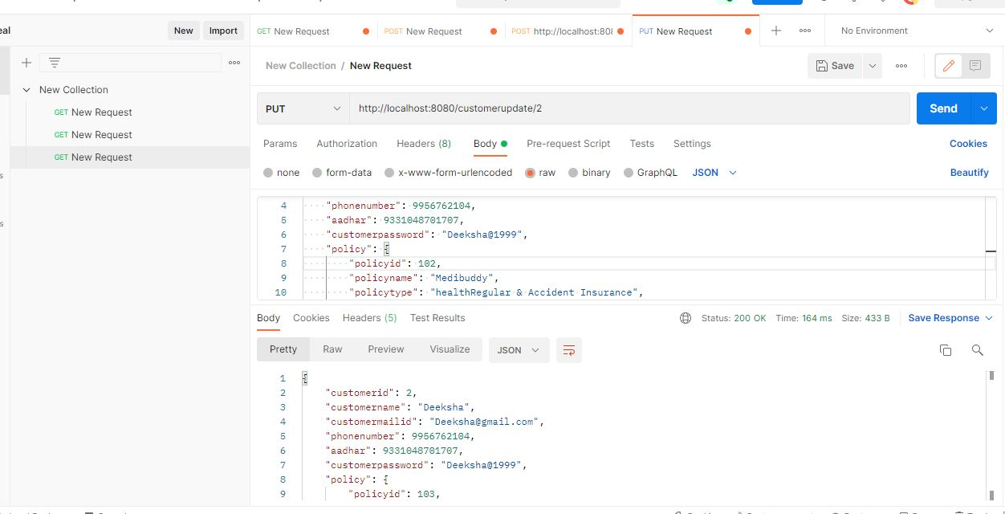
POST MAN METHODS
GET METHOD
Helps to get all the customer details as well as specified customer details.
PUT METHOD
Helps to update the information for the
existing customers and policy.

Slide 15
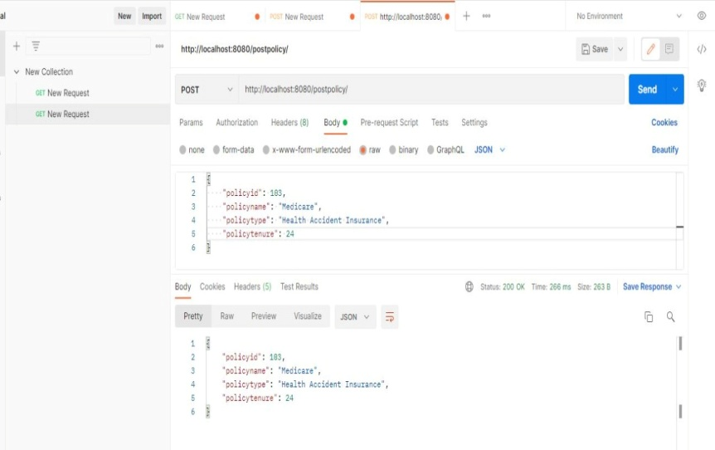
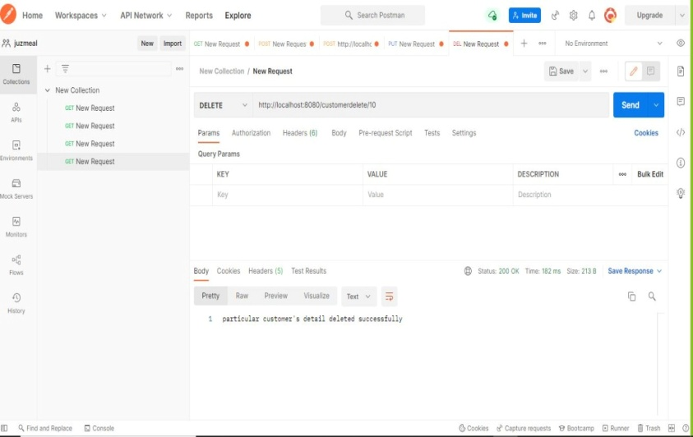
.
POST METHOD
Helps to send the data of the customer
and also policy to create a row for the
particular fields.
DELETE METHOD
It will delete the records as per the client’s
request.

Slide 16
CONCLUSION
Everyone needs to be well informed and concerned about the quality of care.
Everyone means patients and their families, consumer agents and advocates, health professionals, administrators of health plans and facilities, purchasers of health care services, and policymakers at all levels.
So as a part of this health care management process we can give the insurance
policy to the customers and help them

Slide 17
FUTURE WORK
The main goal for the future work will be developing an complete technical support team for helping the customers problems and solving there problems.
some of new policies also will be added.

Slide 18

.

